Slide 1
Chapter 3
Scatterplots and correlation

Slide 2
Why do we use scatterplots?
Used to investigate relationships between quantitative variables.
Types of Variables
Response Variable
Explanatory Variable

Slide 3
Interpreting Scatterplots
Direction
Form
Strength
Outliers

Slide 4
Interpreting Scatterplots
Direction:
Form:
Strength:
Outliers:

Slide 5
Interpreting Scatterplots
Direction:
Form:
Strength:
Outliers:

Slide 6
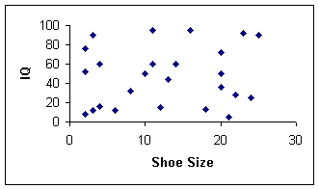
Interpreting Scatterplots
Direction:
Form:
Strength:
Outliers:

Slide 7
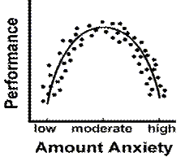
Interpreting Scatterplots
Direction:
Form:
Strength:
Outliers:

Slide 8
Pearson’s Correlation Coefficient
Karl Pearson (1857-1936) was an English lawyer, mathematician and statistician.
He spent most of his career applying statistics in the field of biology.
His contributions to the field of statistics include the correlation coefficient and the chi squared test (coming up later).

Slide 9
Pearson’s Correlation Coefficient
Strength of the linear relationship.
r: Can take all values between -1 and 1 inclusive
r =-1
r = 0
r = +1
r = 1.2
A perfect correlation: all plotted points lie on a straight line.
0 – 0.25 | 0.25 – 0.5 | 0.5 – 0.75 | 0.75 - 1
very weak | weak | moderate | strong

Slide 10
Pearson’s Correlation Coefficient
Strength of the linear relationship.

Slide 11
Pearson’s Correlation Coefficient
$r= \frac{s_{xy}}{s_{x}s_{y}}$ where $s_{xy}$ = covariance, $s_{x} and{ s}_{y}$= standard deviations of x and y.
$s_{xy}= \frac{Σxy}{n}−$ $\frac{Σx}{n}∙\frac{Σy}{n}$
$s_{x}= \sqrt{\frac{Σx^{2}}{n}}−{\overline{x}}^{2}$ $s_{y}= \sqrt{\frac{Σy^{2}}{n}}−{\overline{y}}^{2}$

Slide 12
Pearson’s Correlation Coefficient
$Just kidding….you can use your calculator :)$
Enter the data from p. 177 into list 1 and list 2

Slide 13
CAUTION
Did you know that there is an almost perfect correlation between ice cream sales and drowning deaths in Santa Monica?
CORRELATION DOES NOT IMPLY CAUSATION!!!
In my class you may not use the word cause to describe a statistical relationship. Ever.

Slide 14
CAUTION
Read p.191-193 KNOW THESE!!!!!!!

Slide 15
Activity Extension
Remove the data points 1, 11, 2 and calculate a new correlation coefficient for DAD vs. MOM. What do you notice about the new correlation coefficient when compared to the original r? What does this tell us about r’s resistance to outliers?

Slide 16
3.2: Line of Best Fit

Slide 17
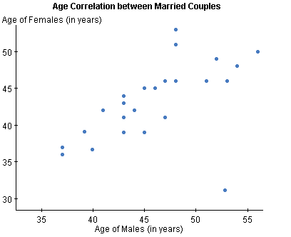
Warm-up
Interpret the following scatterplot in context.
The scatterplot shows a _________ _______ ___________between __(the variables)_____. There is ____ outlier with a male age of _____ and female age of ______The scatterplot appears ________.

Slide 18
Warm-up
Interpret the following scatterplot in context.
The scatterplot shows a moderate, positive association between the ages of men and women in married couples. There is one outlier with a male age of about 53 and a female age of about 30.The scatterplot appears roughly linear.

Slide 19
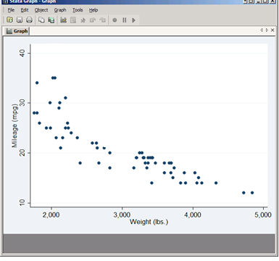
Warm-up
Interpret the following scatterplot in context.
The scatterplot shows a _________ __________ ___________between ______ and ________ . The scatterplot appears ________.

Slide 20
Warm-up
Interpret the following scatterplot in context.
The scatterplot shows a moderate negative association between the weight and mileage of cars in the sample. The scatterplot appears non-linear (somewhat curved).

Slide 21
Reminder…
Association and Correlation are not the same thing.
Association is a somewhat vague term used to describe the direction of data in a scatterplot.
Correlation is a specific term. Correlation refers to the correlation coefficient (r). Unless you are talking about r…you should not be saying anything about correlation.
Also – Correlation does not have units. You cannot say that r = .87 mpg…that would make no sense people.

Slide 22
Line of Best Fit!

Slide 23
Line of Best Fit
A line of best fit is a line that is drawn on a scatterplot so that approximately as many points lie above the line as below it.
To draw a line of best fit by hand:
Find the mean of each set of data and plot this point.
Draw a line that passes through the mean and best represents the data.

Slide 24
Line of Best Fit
$$\overline{x}=2.09$$
$$\overline{\text{y}}=5.23$$
Find the mean of each set of data and plot this point.
Draw a line that passes through the mean and best represents the data.
Hrs Studying | Social Life
0 | 10
0.4 | 10
0.7 | 9
0.7 | 6
0 | 8
0.25 | 7
1.5 | 7
1.3 | 6
1.5 | 10
1.7 | 9
1.8 | 5
Hrs Studying | Social Life
1.8 | 6
2 | 5
2 | 5
3.5 | 3
3 | 5
3.5 | 2
3.7 | 1
3.7 | 0
4 | 1
4 | 0
5 | 0

Slide 25
Line of Best Fit
Find the mean of each set of data and plot this point.
Draw a line that passes through the mean and best represents the data.
$$(2.09, 5.23)$$
Hrs Studying | Social Life
0 | 10
0.4 | 10
0.7 | 9
0.7 | 6
0 | 8
0.25 | 7
1.5 | 7
1.3 | 6
1.5 | 10
1.7 | 9
1.8 | 5
Hrs Studying | Social Life
1.8 | 6
2 | 5
2 | 5
3.5 | 3
3 | 5
3.5 | 2
3.7 | 1
3.7 | 0
4 | 1
4 | 0
5 | 0

Slide 26
Line of Best Fit
Find the mean of each set of data and plot this point.
Draw a line that passes through the mean and best represents the data.
$$(2.09, 5.23)$$
(2.09, 5.23) (4, 1)
(y - 5.23) = -2.2( x – 2.09)
$$\hat{y}= 9.86 – 2.2x$$

Slide 27
Least Squares Regression Line
Line that makes the sum of the squared vertical distances of the data points from the line as small as possible. GOES THROUGH THE MEAN.
$\hat{y}= 9.6 – 2.1x$

Slide 28
Interpret a Regression Line
The equation of the regression line is apprx.
$\hat{y}= 9.6 – 2.1x$
Social life = 9.6 – 2.1 (hrs studied)
The y-intercept is 9.6. What does this represent?
The slope is –2.1. What does this represent?

Slide 29
Careful…
A small slope does not mean an insignificant relationship and a large slope does not necessarily signify importance!!!

Slide 30
Making Predictions
$social life = 9.6 – 2.1\left(hours studying\right)$
What social life score would you predict for a student studying 3 hours per night?

Slide 31
Making Predictions
If a person spends 10 hours studying per night, what would you predict their social life score to be?

Slide 32
Making Predictions
$social life = 9.6 – 2.1\left(hours studying\right)$
If a person has a social life score of 6, how many hours would you predict that they study each night?
You cannot just switch the explanatory and response variables…if you want to find this information you have to find a new equation. (*we are going to break that rule in todays lab….but I want you to be aware*)
Hours studying = 4.13 – 0.3899 (social life)

Slide 33
Calculator…
Put the data into you lists
Hrs Studying | Social Life
0 | 10
0.4 | 10
0.7 | 9
0.7 | 6
0 | 8
0.25 | 7
1.5 | 7
1.3 | 6
1.5 | 10
1.7 | 9
1.8 | 5
Hrs Studying | Social Life
1.8 | 6
2 | 5
2 | 5
3.5 | 3
3 | 5
3.5 | 2
3.7 | 1
3.7 | 0
4 | 1
4 | 0
5 | 0

Slide 34
Barbie Bungee!!!!

Slide 35
Finish Barbie Bungee

Slide 36
Lesson 1.2 Continued
<3 Statistics <3

Slide 37
How do I know if my equation fits the data well?
One way to know this is to look at the scatterplot.
Hrs Studying | Social Life
0 | 10
0.4 | 10
0.7 | 9
0.7 | 6
0 | 8
0.25 | 7
1.5 | 7
1.3 | 6
1.5 | 10
1.7 | 9
1.8 | 5
Hrs Studying | Social Life
1.8 | 6
2 | 5
2 | 5
3.5 | 3
3 | 5
3.5 | 2
3.7 | 1
3.7 | 0
4 | 1
4 | 0
5 | 0

Slide 38
How do I know if my equation fits the data well?
A residual is the difference between an observed value of the response variable and the value predicted by the regression line.
Residual = observed y – expected $\hat{y}$

Slide 39
How do I know if my equation fits the data well?
Residual = observed y – expected $\hat{y}$
$$social life = 9.6 – 2.1\left(hours studying\right)$$

Slide 40
FYI…
A negative residual means that your observation was less than the expected value (the point fell below the line)
A positive residual means that your observation was greater than the expected value (the point fell above the line)

Slide 41
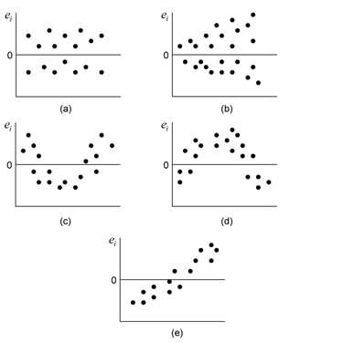
Residual Plot
A residual plot is the plot of the explanatory variable (x-axis) vs. the residuals (y-axis).
If the residual plot has a pattern, the LSRL is not a good fit.

Slide 42
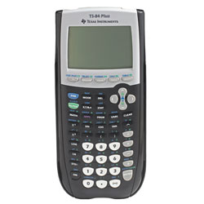
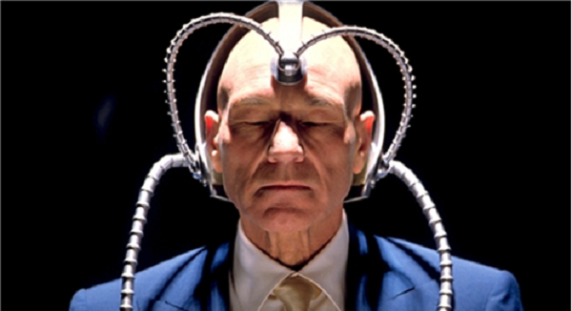
Residual Plot
This get’s annoying to do on the ppt so we are going to use out calculators for a minute…
Things to keep in mind!!!
Residual plots:
YOU HAVE TO RUN LINREG IN ORDER TO HAVE YOU CALCULATOR FIND THE RESIDUALS FOR YOU!!!!
Your calculator cannot read your mind…
Seriously…
It can’t…

Slide 43
Speaking of Residuals…
s (the standard deviation of the residuals) can be found using the formula
$$s=\sqrt{\frac{Σ{residuals}^{2}}{n−2}}$$
The standard deviation gives you the average error you should expect when using your LSRL to make predictions.
For the social life data s = 1.536
In context: When using our regression line to make predictions of social life score based on hours studying we can expect to be off by an average of about 1.536 social life “points”.

Slide 44
Residual Plots are kind of time consuming…
We have another way to talk about how well out line fits the data…and it’s really easy to find. (HOWEVER…if you are asked about the fit of our line should always do both ☺)

Slide 45
Coefficient of Determination
$r^{2}=the coefficient of determination$
It is literally r (correlation coefficient) squared.
Specifically, it tells us….
“The percentage of the variation in the values of y (our response variable) that can be explained by the variation of x (our explanatory variable).”
OR “The percentage of the variation in the values of y that can be explained by the least squares regression line of y on x”

Slide 46
Coefficient of Determination
$\hat{y}= 9.6 – 2.1x$
$r^{2}=.81$
“81% of the variation in social life scores can be explained by the variation in hour spent studying per night”
“81% of the variation in social life scores is explained by the least-squares regression line relating social life scores to # hours studied per night”

Slide 47
Important Facts about the LSRL
READ p. 225-226

Slide 48
3.3: Correlation Wisdom
I am going to go over this on the review day (Monday)
HOWEVER…even if you are absent on Friday you are expected to understand this material and will take the test on Monday!!!!
Email me if you have questions.
Outliers– any data point that falls outside of the pattern.
Influential Observations – removing the point would markedly change the calculation.

