Slide 1
Set Notation Math Studies IB NPHS Mrs Skaff

Slide 2
Set Notation Chart
Symbol | Symbol Name
ℝ
ℚ
ℕ
ℤ
U
∈
∉
⊆
Ø
⊂
∩
∪
A’
n(A)
⊄

Slide 3
Set Theory
A set is a well defined group of objects or symbols
The objects or symbols are called the elements of the set.
If an element e belongs to set S, this is represented as:
e ∈ S
If an element e does NOT belong to set S this is represented as:
e ∉ S

Slide 4
Set Theory
If an element e belongs to set S, this is represented as:
e ∈ S
If an element e does NOT belong to set S this is represented as:
e ∉ S
EXAMPLE:
A particular set consists of the following elements: {South Africa, Namibia, Egypt, Angola, ..}
Describe the set: ______________________
The elements are the countries of Africa
Add another two elements to the set
Nigeria ∈ Countries in Africa
France ∉ Countries in Africa
Is the set finite or infinite?

Slide 5
Set Theory
If an element e belongs to set S, this is represented as:
e ∈ S
If an element e does NOT belong to set S this is represented as:
e ∉ S
EXAMPLE:
Consider the set {1, 4, 9, 16, 25, …}
Describe the set: ________________________
The elements of the set are square numbers
Add another two elements to the set
36 ∈ square numbers
12∉ square numbers
Is the set finite or infinite?

Slide 6
Subsets
If the elements of one set X are also the elements of another set Y, then X is said to be a subset of Y
X ⊆ Y
If a set is empty (i.e., it has no elements in it) then it is called an empty set.
Represented by the symbol Ø
The empty set is a subset of all sets.
A = {Tor, Bella, Stephanie}
B= {Tor, Bella, Stephanie}
C= {Tor, Bella}
D= {Tor, Stephanie}
E= {Bella, Stephanie}
F= {Tor}
G= {Bella}
H= {Stephanie}
I = Ø
All of these are subsets of A.
Ø ⊆ A, A ⊆ A
Sets C – H are considered proper subsets of A.
C ⊂ A

Slide 7
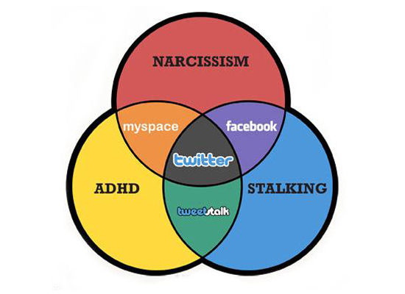

Slide 8
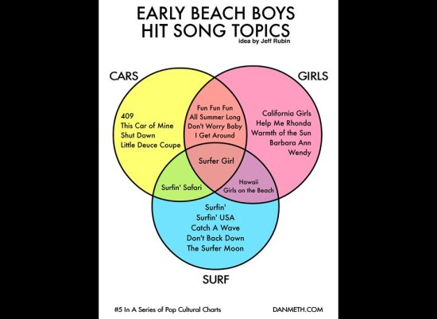

Slide 9
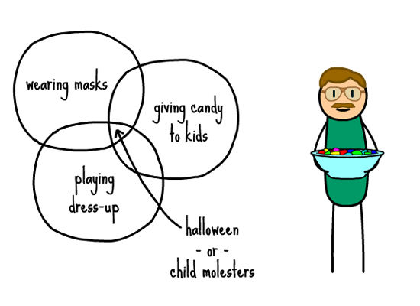

Slide 11
Venn diagrams
A Venn diagram is a good way of visually representing the elements of sets
The Universal set U in this case contains all the integers from 1 to 24.
U = {1, 2, 3, 4, 5, 6, 7, 8, 9, 10, 11, 12, 13, 14, 15, 16, 17, 18, 19, 20, 21, 22, 23, 24}
U
18
1
3
12
4
23
6
16
2
9
24
20
5
22
21
8
15
10
19
17
14
13
11
7

Slide 12
Venn diagrams
If the set A contains all the multiples of 3 between 1 and 24, this can
be written as
A = {3, 6, 9, 12, 15, 18, 21, 24}.
On the diagram these can be identified by enclosing them in a circle
labelled A.
U
A
18
1
3
12
4
23
6
16
2
9
24
20
5
22
21
8
15
10
19
17
14
13
11
7

Slide 13
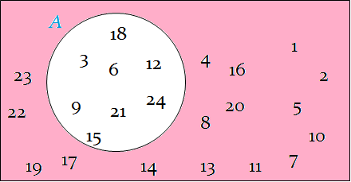
Venn diagrams
The complement of set A is the set of elements which are in U but not in A.
This set is identified as A’
If the set A contains all the multiples of 3 between 1 and 24, what is A’?
U ={1, 2, 3, 4, 5, 6, 7, 8, 9, 10, 11, 12, 13, 14, 15, 16, 17, 18, 19, 20, 21, 22, 23, 24}
A = {3, 6, 9, 12, 15, 18, 21, 24}.
A’ = {1, 2, 4, 5, 8, 10, 11, 13, 14, 16, 17, 19, 20, 22, 23}
U
A
18
1
3
12
4
23
6
16
2
9
24
20
5
22
21
8
15
10
19
17
14
13
11
7

Slide 14
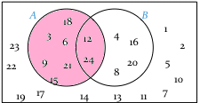
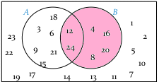
Venn diagrams
If the set B contains all the multiples of 4 between 1 and 24, this can be written as
B = {4, 8, 12, 16, 20, 24}.
On the diagram these can be identified by enclosing them in another circle labelled B.
U
A
18
B
1
3
12
4
23
6
16
2
9
24
20
5
22
21
8
15
10
19
17
14
13
11
7

Slide 15
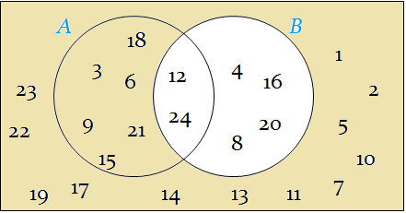
Venn diagrams
Shade the part of the Venn Diagram that represents the set B’
U
A
18
B
1
3
12
4
23
6
16
2
9
24
20
5
22
21
8
15
10
19
17
14
13
11
7

Slide 16
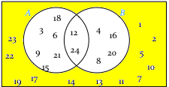
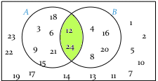
Venn diagrams
The numbers 1, 2, 5, 7, 10, 11, 13, 14, 17, 19, 22, 23 all belong to the Universal set U but do not belong to either set A or set B.
U
A
18
B
1
3
12
4
23
6
16
2
9
24
20
5
22
21
8
15
10
19
17
14
13
11
7
The numbers 12 and 24 belong to set A and set B and therefore they appear in the overlap of the two circles.
The overlap (intersection) of set A and set B is written A∩B
therefore A∩B = {12,24}.

Slide 17
Venn diagrams
The numbers which belong to either set A or set B or both (the union of A and B) are described as A ∪B therefore
A ∪ B = {3, 4, 6, 8, 9, 12, 15, 16, 18, 20, 21, 24}.
U
U
A
B
A
18
B
18
1
3
4
1
3
12
4
6
12
16
23
6
16
2
23
2
24
9
24
9
20
5
22
21
20
5
22
21
8
8
15
10
15
10
7
17
7
19
17
14
13
11
19
14
13
11

Slide 18
Human Venn Diagram!
A = { }.
B = { }.

Slide 19
Drawing Venn Diagrams
Draw a Venn Diagram to represent the set U = {2, 3, 5, 7, 8} and A = {2, 7, 8}
5
U
3
A
2
7
8

Slide 20
Drawing Venn Diagrams
Draw a Venn Diagram to represent A ⊆B⊆U
“A is a subset of B which is a subset of U”
U
B
A

Slide 21
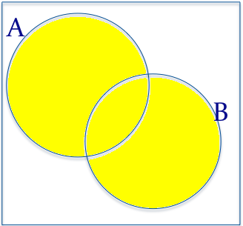
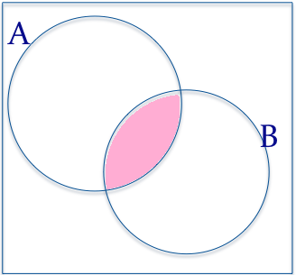
Drawing Venn Diagrams
Draw a Venn Diagram to represent A⊆U, B⊆U, A∩B≠Ø
A
U
A∩B
AUB
B

Slide 22
Example
There are 65 golf players at a charity tournament. 45 of these players will play 9 holes of golf and 40 will play 18 holes. There are 5 people at the tournament who have decided not to play at all. How many people will play both 9 holes and 18 holes of golf?

Slide 23
Example
In a survey of children who saw three different shows at Walt Disney World, the following information was gathered:
39 children liked The Little Mermaid
43 children liked 101 Dalmatians
56 children liked Mickey Mouse
7 children liked The Little Mermaid and 101 Dalmatians
10 children liked The Little Mermaid and Mickey Mouse
16 children liked 101 Dalmatians and Mickey Mouse
4 children liked The Little Mermaid, 101 Dalmatians, and Mickey Mouse
6 children did not like any of the shows
How many children were surveyed?

Slide 24
Example
In a survey of children who saw three different shows at Walt Disney World, the following information was gathered:
39 children liked The Little Mermaid
43 children liked 101 Dalmatians
56 children liked Mickey Mouse
7 children liked The Little Mermaid and 101 Dalmatians
10 children liked The Little Mermaid and Mickey Mouse
16 children liked 101 Dalmatians and Mickey Mouse
4 children liked The Little Mermaid, 101 Dalmatians, and Mickey Mouse
6 children did not like any of the shows
How many children were surveyed?
Little Mermaid
101 Dalmatians
26
24
3
4
16
6
14
6
U
Mickey Mouse

