Slide 5
A television station broadcast a court trial in its entirety. During a news program, viewers were asked to go to the TV station’s website and state whether they thought the defendant was guilty or not guilty. Of the 1,840 viewers who gave their opinion, 1,521 felt that the defendant was not guilty. The viewers who registered their opinions constitute
A: a population.
B: a convenience sample.
C: a voluntary response sample.
D: a probability sample.
E: a stratified random sample.

Slide 6
AP Statistics
Chapter 5.2: Designing Experiments

Slide 7
Parts of an Experiment
Experimental Units: Individuals on which the experiment is being performed, (called subjects or participants when human)
Treatment: An experimental condition applied to the units.
Factors: The explanatory variables in an experiment.
Level: A specific value of a factor

Slide 8
Treatment: An experimental condition applied to the units.
Factors: The explanatory variables in an experiment.
Level: A specific value of a factor
Combination of levels and factors form the treatment.
Ex….
You are doing an experiment on dosage and method of delivery for a drug.
2 Factors: Dosage, temperature
2 Levels for each factor: Dosage -- 200mg, 400mg ; Method – orally, intravenously
4 Treatments: 200mg orally, 400m orally, 200mg intravenously, 400mg intravenously

Slide 9
Principles of Experimental Design
1. Control
2. Replication
3. Randomization
Goal: Find statistical significance…the observed effect is so large that it is unlikely to have occurred by chance.

Slide 10
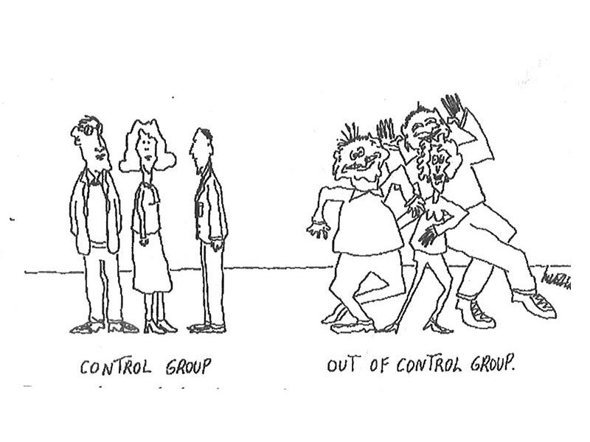
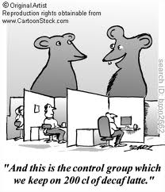
Principles of Experimental Design
1. Control
Minimize the effects of lurking variables by comparing several treatments in the same environment. (utilize placebos and control groups)
Placebo Effect: response to a dummy treatment

Slide 11
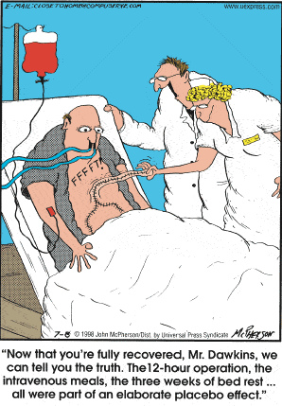

Slide 12
Principles of Experimental Design
2. Replication
Use many experimental units to reduce chance variation in the results

Slide 13
Principles of Experimental Design
3. Randomization
Use impersonal chance to assign experimental units to treatments.

Slide 14
Types of Experimental Designs
Completely Randomized Design
aka a basic comparative experiment
All experimental units are allocated at random among all the treatments
Example:
I want to test a new drug that supposedly lowers cholesterol.
I decide to test two different treatments (100mg of the drug and 200mg of the drug)
Include a control group

Slide 15
Comparative Experiment

Slide 16
Types of Experimental Designs
Block Design
An experiment is conducted separately for different groups (blocks) of experimental units.
Use blocks only if you expect certain groups of units/subjects to systematically affect the response to the treatments.
Example:
I want to test a new drug that supposedly lowers cholesterol.
100mg of the drug, 200mg of the drug, control group
I have reason to believe that subjects that are 65+ will react differently to the drug than subjects who are under 65.

Slide 17
Block Design

Slide 18
Types of Experimental Designs
Matched Pairs Design (type of block design)
Compares two treatments by comparing the response of two matched experimental units.
Units are matched one of two ways….
(a) Two different units/subjects matched based on similar characteristics (e.g. identical twins)
(b) One subject/unit receives both treatments (i.e. A person is paired with him/herself. Each subject serves as his/her own control.)
Randomization is still used to determine who gets which treatment, or which treatment is given first.

Slide 19
Matched Pairs
Does this new basketball I made increase the number of free-throws made?
(a) Two different units/subjects matched based on similar characteristics
(b) One subject/unit receives both treatments (i.e. A person is paired with him/herself. Each subject serves as his/her own control.)

Slide 20
Type (a): Free-Throws Made with Ball type A vs. Ball type B
Match subjects based on height
Randomly assign subjects in each pair to ball type A or ball type B by flipping a coin
Test the subjects
Compare results from ball type A and Ball type B

Slide 21
Type (b): Free-Throws Made with Ball type A vs. Ball type B
Every subject tests both basketball types
Randomly assign subjects in start with either type A or type B.
Test the subjects with both types of basketballs (in the order decided on by chance)
Compare results from ball type A and Ball type B

Slide 22
Which one?
Does this new basketball I made increase the number of free-throws made?
(a) Two different units/subjects matched based on similar characteristics
(b) One subject/unit receives both treatments (i.e. A person is paired with him/herself. Each subject serves as his/her own control.)

Slide 23
Example: Fertilizing a Field

Slide 24
Other Considerations with Experiments
It is sometimes better if the experiment is conducted in a double-blind manner.
Neither the subjects nor the people administering the experiment know which treatment the subjects received.
Sometimes a lack of realism is a problem for experiments.
A laboratory setting is not always the same as real life, which makes it difficult to generalize your findings.

Slide 25
Other Considerations Cont…
Don’t forget to describe your randomization process in detail when writing an open-ended response.
Random sample
Allows you to generalize your results to the population
Random allocation to treatment groups
Allows you to state that the difference between the responses in the treatment groups was due to the effects of the explanatory variable, not the personal characteristics of the subjects.

