Slide 1
Chapter 9.1 Sampling Distributions

Slide 2
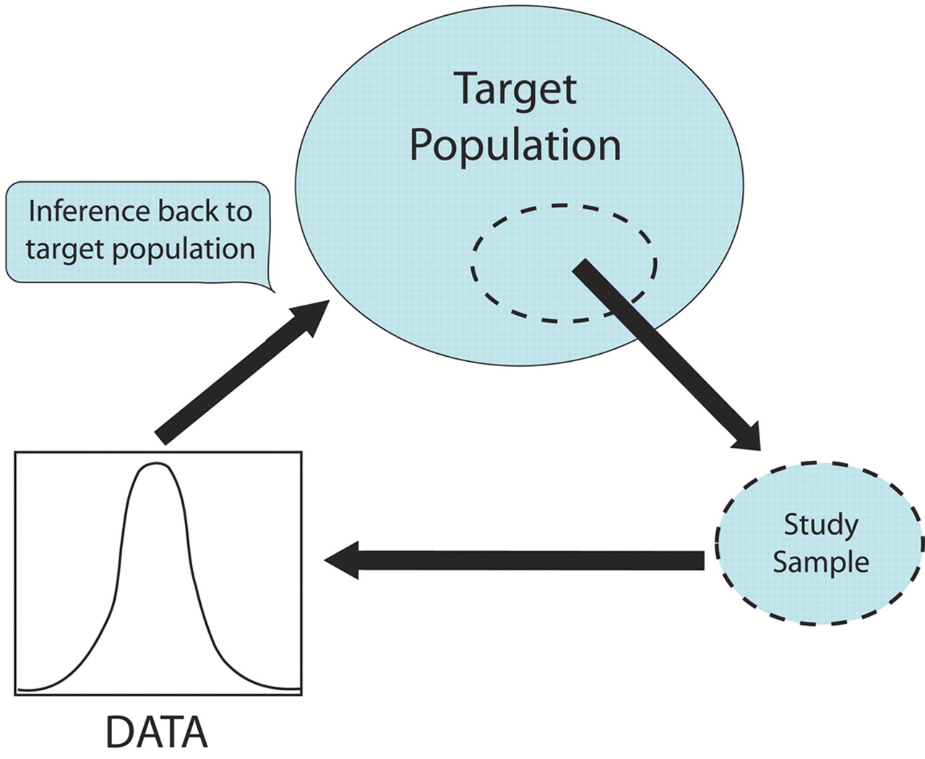
Statistical Inference:

Slide 3
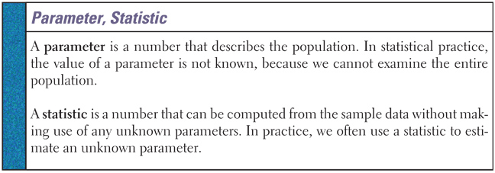
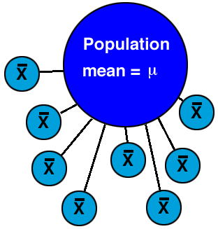

Slide 4
Statistic & Parameter
In our population of pennies, the mean was _________ and the standard deviation was _________.
Let’s say you took a sample of 25 pennies (n=25), and found that the average age was 24 and the standard deviation was 8.

Slide 5
Statistic & Parameter
The Gallup Poll asked a random sample of 515 US adults whether they believe in ghosts. Of the respondents, 160 said “Yes”. Identify the statistic and parameter of interest.

Slide 6
For each boldface number, state whether it is a statistic or a parameter.
1) A department store sends a survey to its customers and finds that 84% of the respondents had a positive shopping experience.
2) A consumer group, after testing 100 batteries of a certain brand, reported an average life of 63 hours of use.
3) The Department of Motor vehicles reports that 22% of all vehicles registered in a particular state are imports.
4) A hospital reports that based on the ten most recent cases, the mean length of stay for surgical patients is 6.4 days.
5) The mean age at university is 24.1 years.

Slide 7
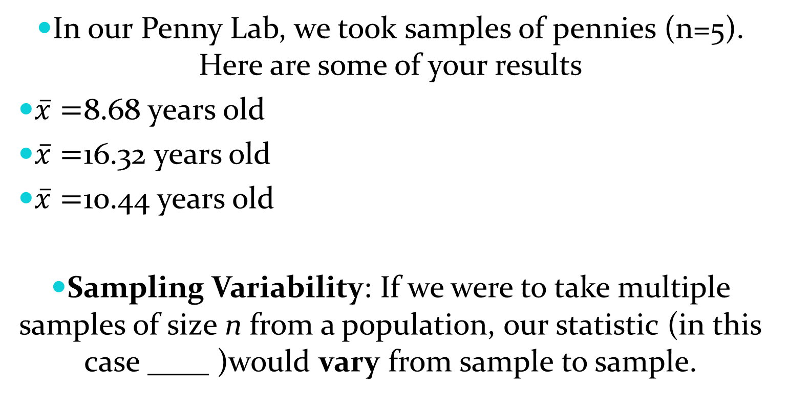
Sampling Variability:
In our Penny Lab, we took samples of pennies (n=5). Here are some of your results
$\overline{x}=$8.68 years old
$\overline{x}=$16.32 years old
$\overline{x}=$10.44 years old
Sampling Variability: If we were to take multiple samples of size n from a population, our statistic (in this case ____ )would vary from sample to sample.

Slide 8
In our Penny Lab, we only took 100 samples of n=5. If f we took every possible sample of size 5 from our population, and graphed each of those $\overline{x}$’s, we would have a sampling distribution.
Definition: The sampling distribution of a statistic is the distribution of values taken by the statistic in all possible samples of the same size from the population.
Sampling Distributions

Slide 9
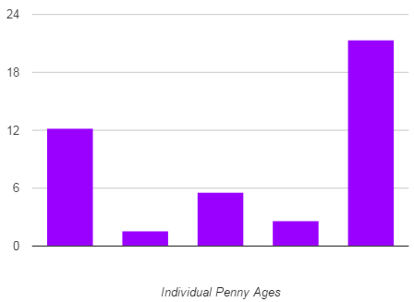
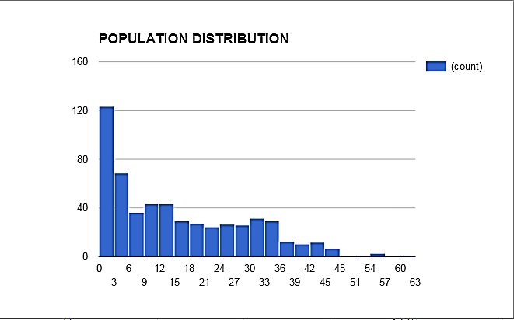
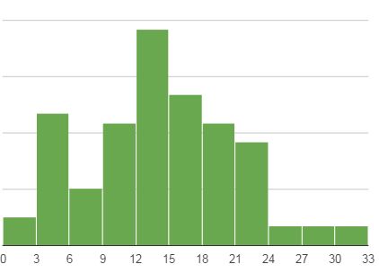
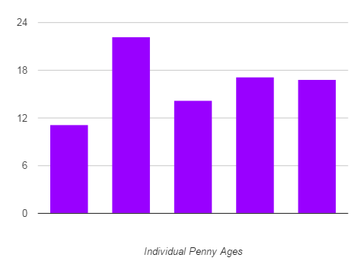
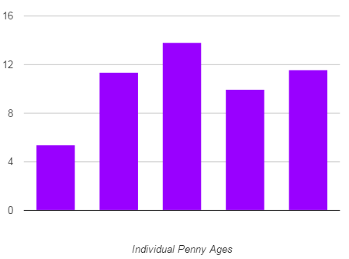
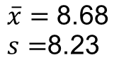
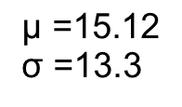
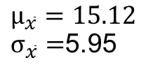
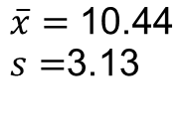
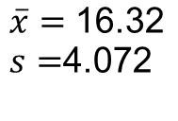
Distribution
of Sample Data
Population Distribution
$$\overline{x}=\text{8.68}$$
$s=$8.23
Sampling Distribution
$$\overline{x}=\text{16.32}$$
$s=$4.072
$$\text{μ}\text{ =}\text{15.1}\text{2}$$
σ =13.3
$$\overline{x}$$
$$μ_{\overline{x}}=15.12$$
$σ_{\overline{x}}=$5.95
$$\overline{x}=\text{10.44}$$
$s=$3.13

Slide 10
Describing Sampling Distributions

Slide 11
Center - Unbiased Statistic/ Unbiased Estimator
Population Distribution
Sampling Distribution
$$\text{μ}\text{ =}\text{15.1}\text{2}$$
$$μ_{\overline{x}}=15.12$$

Slide 12
Unbiased Estimator
To get a trustworthy estimate of an unknown parameter, you must start by using a statistics that is an unbiased estimator.
Unfortunately, even an unbiased estimator will vary!
$$μ_{\overline{x}}=15.12$$

Slide 13
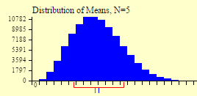
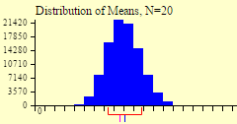
Spread - Variability
The variability of a statistic is described by the spread of its sampling distribution.
The spread is determined by the size of the sample.
Larger samples =
Why would we want our sampling distribution to have LOW variability?

Slide 14
Spread - Variability
The spread of the sampling distribution does not depend on population size as long as the population is at least 10 times larger than the sample. (10% Rule….will be very important ☺)
An SRS of size 1500 from the entire population of the United States (about 300 million) and an SRS of 1500 from San Francisco (~750,000) would have about the same variability (if all other things are equal)

Slide 15
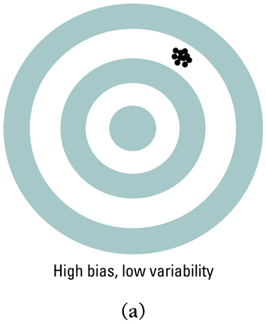
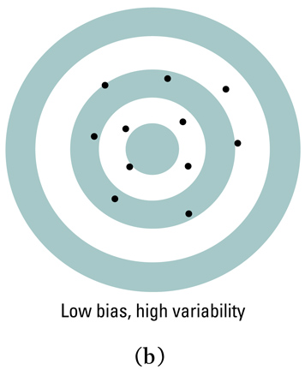
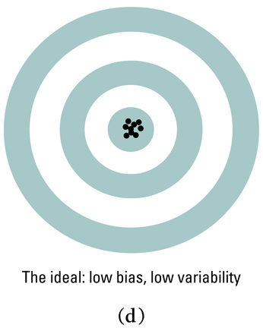
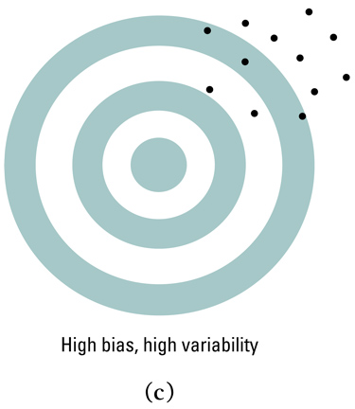
Properly chosen statistics computed from random samples of sufficient size will have low bias and low variability

