Slide 1
Chapter 5.2
Scatterplots and correlation

Slide 2
Why do we use scatterplots?
Used to investigate relationships between quantitative variables.
Types of Variables
Response Variable
Explanatory Variable

Slide 3
Interpreting Scatterplots
Direction
Form
Strength
Outliers

Slide 4
Interpreting Scatterplots
Direction:
Form:
Strength:
Outliers:

Slide 5
Interpreting Scatterplots
Direction:
Form:
Strength:
Outliers:

Slide 6
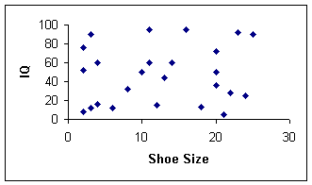
Interpreting Scatterplots
Direction:
Form:
Strength:
Outliers:

Slide 7
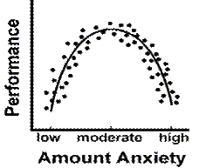
Interpreting Scatterplots
Direction:
Form:
Strength:
Outliers:

Slide 8
Interpret IN CONTEXT
The scatterplot shows a (______ _______ association) between __(the variables)_____. There are no outliers/There is/are (an) outlier (describe outlier). The scatterplot appears ________.

Slide 9
The scatterplot shows a (______ _______ association) between __(the variables)_____. There are no outliers/There is/are (an) outlier (describe outlier). The scatterplot appears ________.

Slide 10
The scatterplot shows a (______ _______ association) between __(the variables)_____. There are no outliers/There is/are (an) outlier (describe outlier). The scatterplot appears ________.

Slide 11
Numbers!
If we are given the actual data, we can quantify the relationship between two variables.
In addition to describing the association (the “visual” pattern), we can calculate the correlation coefficient (the numerical value that represents the association)

Slide 12
Pearson’s Correlation Coefficient
Karl Pearson (1857-1936) was an English lawyer, mathematician and statistician.
He spent most of his career applying statistics in the field of biology.
His contributions to the field of statistics include the correlation coefficient and the chi squared test (coming up later).

Slide 13
Pearson’s Correlation Coefficient
Strength of the linear relationship.
r: Can take all values between -1 and 1 inclusive
r =-1
r = 0
r = +1
r = 1.2
A perfect correlation: all plotted points lie on a straight line.
0 – 0.25 | 0.25 – 0.5 | 0.5 – 0.75 | 0.75 - 1
very weak | weak | moderate | strong

Slide 14
Pearson’s Correlation Coefficient
A set of variables has a correlation coefficient of r = -0.8. Describe the correlation.

Slide 15
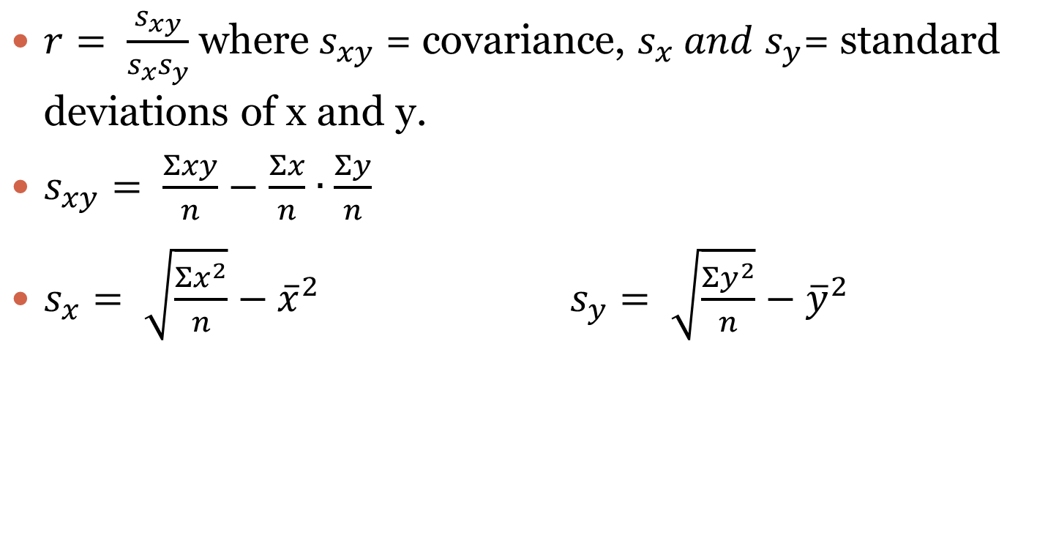
Pearson’s Correlation Coefficient
$r= \frac{s_{xy}}{s_{x}s_{y}}$ where $s_{xy}$ = covariance, $s_{x} and{ s}_{y}$= standard deviations of x and y.
$s_{xy}= \frac{Σxy}{n}−$ $\frac{Σx}{n}∙\frac{Σy}{n}$
$s_{x}= \sqrt{\frac{Σx^{2}}{n}}−{\overline{x}}^{2}$ $s_{y}= \sqrt{\frac{Σy^{2}}{n}}−{\overline{y}}^{2}$

Slide 16

Pearson’s Correlation Coefficient
$Using your calculator :)$
Student | 1 | 2 | 3 | 4 | 5 | 6 | 7 | 8
Economics Test Score | 64 | 55 | 43 | 84 | 67 | 49 | 92 | 31
Biology test Score | 53 | 42 | 44 | 79 | 75 | 52 | 84 | 29

Slide 17
CAUTION
Did you know that there is an almost perfect correlation between ice cream sales and drowning deaths in Santa Monica?

Slide 18
CAUTION
Did you know that there is an almost perfect correlation between ice cream sales and drowning deaths in Santa Monica?
CORRELATION DOES NOT IMPLY CAUSATION!!!
In my class you may not use the word cause to describe a statistical relationship. Ever.

Slide 19
CAUTION
Read p.191-193 KNOW THESE!!!!!!!

