Slide 1
Describing Location in a Distribution
2.1 Measures of Relative Standing
and Density Curves
YMS3e
AP Stats at NPHS
Mrs. Skaff

Slide 2
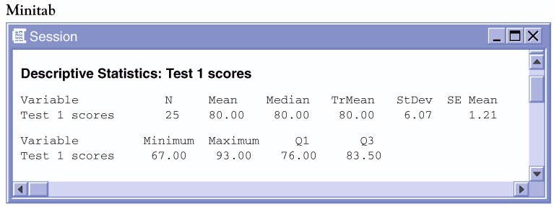

Sample Data
Consider the following test scores for a small class:
79 | 81 | 80 | 77 | 73 | 83 | 74 | 93 | 78 | 80 | 75 | 67 | 73
77 | 83 | 86 | 90 | 79 | 85 | 83 | 89 | 84 | 82 | 77 | 72
Jenny’s score is noted in red. How did she perform on this test relative to her peers?
6 | 7
7 | 2334
7 | 5777899
8 | 00123334
8 | 569
9 | 03
6 | 7
7 | 2334
7 | 5777899
8 | 00123334
8 | 569
9 | 03
Her score is “above average”...
but how far above average is it?

Slide 3
Standardized Value
One way to describe relative position in a data set is to tell how many standard deviations above or below the mean the observation is.
Standardized Value: “z-score”
If the mean and standard deviation of a distribution are known, the “z-score” of a particular observation, x, is:

Slide 4
79 | 81 | 80 | 77 | 73 | 83 | 74 | 93 | 78 | 80 | 75 | 67 | 73
77 | 83 | 86 | 90 | 79 | 85 | 83 | 89 | 84 | 82 | 77 | 72
According to Minitab, the mean test score was ____ while the standard deviation was _____ points.
Julia’s score was above average. Her standardized z-score is:
Julia’s score was almost one full standard deviation above the mean. What about Kevin: x= 72

Slide 5
Calculating z-scores
79 | 81 | 80 | 77 | 73 | 83 | 74 | 93 | 78 | 80 | 75 | 67 | 73
77 | 83 | 86 | 90 | 79 | 85 | 83 | 89 | 84 | 82 | 77 | 72
Julia: z=(86-80)/6.07
z= 0.99 {above average = +z}
6 | 7
7 | 2334
7 | 5777899
8 | 00123334
8 | 569
9 | 03
Kevin: z=(72-80)/6.07
z= -1.32 {below average = -z}
Katie: z=(80-80)/6.07
z= 0 {average z = 0}

Slide 6

Comparing Scores
Standardized values can be used to compare scores from two different distributions.
  Statistics Test: mean = 80, std dev = 6.07
  Chemistry Test: mean = 76, std dev = 4
  Jenny got an 86 in Statistics and 82 in Chemistry.
  On which test did she perform better?
Statistics
Chemistry
Although she had a lower score, she performed relatively better in Chemistry.

Slide 7
Percentiles
Another measure of relative standing is a percentile rank.
p^{th} percentile: Value with p % of observations at or below it.
  median = 50th percentile {mean=50th %ile if symmetric}
  Q1 = 25th percentile
  Q3 = 75th percentile
6 | 7
7 | 2334
7 | 5777899
8 | 00123334
8 | 569
9 | 03
Jenny got an 86.
22 of the 25 scores are ≤ 86.
Jenny is in the 22/25 = 88th %ile.
Your percentile is NOT your score or your % correct

Slide 8
Relative Cumulative Frequency Plots (Ogives)
One way to look at percentiles graphically is to create a relative cumulative frequency plot (Ogive).

Slide 9
Remember the Salary Data?
Suppose we want to know the percentile of Statistics majors. In other words, we want to know what percent of majors make the same or less money than Stats majors.
Chemical Engineering $69,600
Electrical Engineering $65,900
Computer Science $61,600
Statistics $54,900
Economics $51, 400
Business Administration $45,500
Political Science $42,800
Environmental Science $42,000
Fashion Design $41,100
Communications $41,000
Philosophy $40,700
Biology $40,700
Journalism $39,000
Graphic Design $38,400
Education $38,100
Psychology $37,300
Social Work $32,800

Slide 10
Philosophy $40,000
Biology $40,000
Communications $38,700
Fashion Design $36,700
Journalism $36,300
Education $36,200
Graphic Design $36,000
Psychology $36,000
Social Work $33,400
Chemical Engineering $65,700
Electrical Engineering $60,200
Computer Science $56,400
Economics $50,200
Statistics $48,600
Environmental Science $43,300
Business Administration $43,300
Political Science $41,300
Interval | Frequency | Cum Freq. | Rel. Cum. Freq.
30 < $ < 35 | 1 | 1 | .06
35 < $ < 40 | 6 | 7 | .41
40 < $ < 45 | 5 | 12 | .71
45 < $ < 50 | 1 | 13 | .76
50 < $ < 55 | 1 | 14 | .82
55 < $ < 60 | 1 | 15 | .88
60 < $ < 65 | 1 | 16 | .94
65 < $ < 70 | 1 | 17 | 1.00

Slide 11
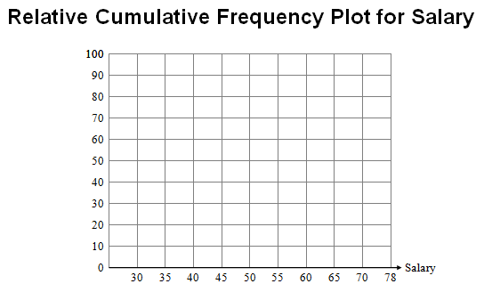
Interval | RCF
30 < $ < 35 | .06
35 < $ < 40 | .41
40 < $ < 45 | .71
45 < $ < 50 | .76
50 < $ < 55 | .82
55 < $ < 60 | .88
60 < $ < 65 | .94
65 < $ < 70 | 1.00
a) In what percentile is a Statistician’s salary ($54,900)?
b) Find the center of the distribution. What degree earns a salary closest to the center?

Slide 12
Heights
Line up around in the room in height order.
x-bar =
s =
Find your percentile and your z-score

Slide 13
Classwork/Homework
CW: 2.7
HW: 2.5(omit e), 2.6, 2.8, 2.12, 2.13, 2.19
Being Chapter 2 Vocab
NO TYPING

