Slide 1
10-2
Estimating a Population Mean
(σ Unknown)

Slide 2
Estimating a Population Mean
STATE and CHECK the Random, 10%, and Normal/Large Sample conditions for constructing a confidence interval for a population mean.
EXPLAIN how the t distributions are different from the standard Normal distribution and why it is necessary to use a t distribution when calculating a confidence interval for a population mean.
DETERMINE critical values for calculating a C% confidence interval for a population mean using a table or technology.
CONSTRUCT and INTERPRET a confidence interval for a population mean.

Slide 3
Question --
On average, how long can a junior/senior in high-school hold his/her breath?
On average, how many pets do NP jrs/seniors have?
On average, how long can NP jrs/srs hold a plank?!
On average, how many minutes of exercise to NP jrs/srs get per day?

Slide 4
We know that a confidence interval has the following form:
Statistic ± (critical value) (standard deviation of the statistic)

Slide 5
The t distributions
When we substitute the standard error of $\overline{x}$ ($\frac{s}{\sqrt{n}}$)for its standard deviation ($\frac{σ}{\sqrt{n}}$) we get the distribution of the resulting statistic, t.
We call it the t distribution.

Slide 6
The t-statistic was introduced in 1908 by William Sealy Gosset, a chemist working for the Guinness brewery in Dublin, Ireland ("Student" was his pen name). Gosset devised the t-test as a way to cheaply monitor the quality of stout.

Slide 7
The t distributions
There is a different t-distribution for each sample size n.
We specify a t distribution by giving its degrees of freedom, which is equal to n-1
We will write the t distribution with k degrees of freedom as t(k) for short.

Slide 8
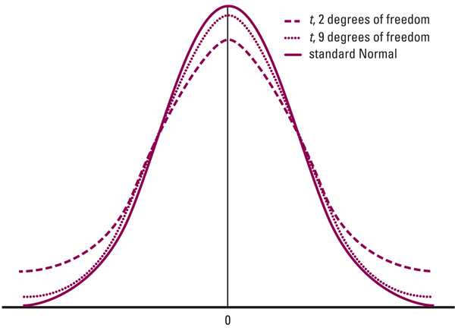
Comparing t and z distributions
Compare the shape, center, and spread of the t-distribution with the z-distribution.

Slide 9
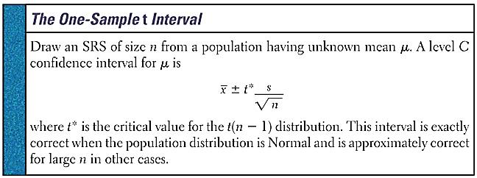

Slide 10
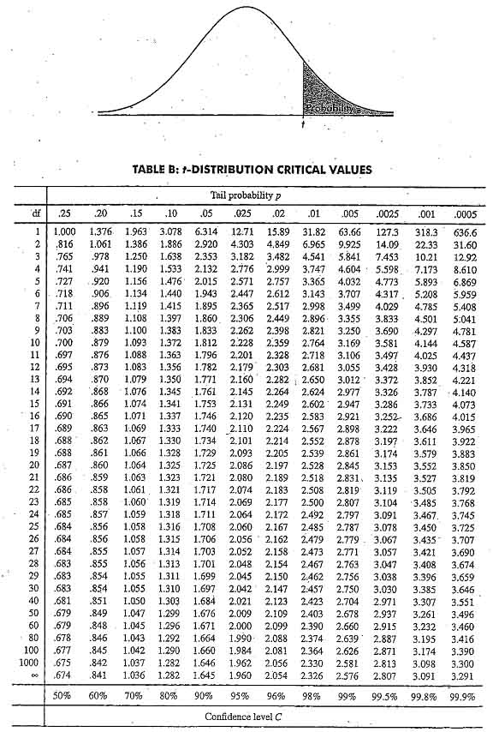
Finding t with Table C
Suppose you want to construct a 95% confidence interval for the mean μ of a population based on a SRS of size n=10. What critical value t should you use?

Slide 11
Finding t with Table C
Suppose you want to construct a 99% confidence interval for the mean μ of a population based on a SRS of size n=34. What critical value t should you use?

Slide 12
One sample t interval for $μ$
1)Random Sample/Random Assignment
2) 10% Rule
3) Large/Counts Normality (if you have the raw data you must draw a boxplot!!!)
- n < 15 : Use t procedures if data are close to Normal with no outliers
- n ≥ 15 : Use t procedures except in cases of outliers of strong skew
- n ≥ 30 : Use t-procedures even for clearly skewed distributions (cannot have extreme outliers)

Slide 13
One sample t interval for $μ$
Let’s use our class data to construct a 95% confidence interval for the true mean

Slide 14
One sample t interval for mu
Step 1: STATE
Step 2: PLAN
Step 3: DO
Step 4: CONCLUDE

Slide 15
State: We are estimating ________, the true mean ________________________________
______________________________.
Plan:
Procedure:
Conditions: 1)
2)
3)

Slide 16
DO:
CONCLUDE: We are 95% confident that the true mean

Slide 17
Paired t-procedures
To compare the responses of the two treatments in a matched pairs design or before and after measurements on the same subjects, apply the one sample t procedures to the differences observed between the pairs.
• µ_{diff} = the mean difference between each pair
Ex) Mrs. Skaff gave a new study tool to her students to see if it would improve their test scores. She matched students based on current grade and randomly gave one student in each pair the study tool.

Slide 18
Paired t-procedures
• µ_{diff} = the mean difference in student grades (given a study tool – not given a study tool).
Ex) Mrs. Skaff gave a new study tool to her students to see if it would improve their test scores. She matched students based on current grade and randomly gave one student in each pair the study tool. She wants to know if the study tool improved test scores.
92 | 73 | 81 | 89 | 95 | 90 | 96 | 72 | 85 | 88
90 | 73 | 84 | 84 | 88 | 91 | 93 | 70 | 80 | 88
Given Study Tool
No Study Tool

Slide 19
Paired t-procedures
• µ_{diff} = the mean difference in student grades (given a study tool – not given a study tool).
Ex) Mrs. Skaff gave a new study tool to her students to see if it would improve their test scores. She matched students based on current grade and randomly gave one student in each pair the study tool. She wants to know if the study tool improved test scores.
Study tool - none
2 | 0 | -3 | 5 | 7 | -1 | 3 | 2 | 5 | 0
State:
Plan:

Slide 20
Paired t-procedures
• µ_{diff} = the mean difference in student grades (given a study tool – not given a study tool).
Ex) Mrs. Skaff gave a new study tool to her students to see if it would improve their test scores. She matched students based on current grade and randomly gave one student in each pair the study tool. She wants to know if the study tool improved test scores.
Do:
Conclude:
We are 95% confident that the true mean difference in student grades (given a study tool – not given a study tool) is between

Slide 21
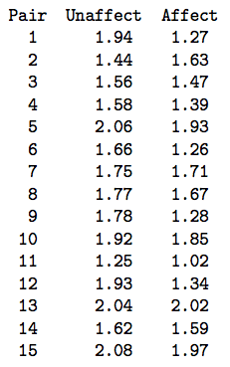
Example
Are there physiological indicators associated with schizophrenia? In a 1990 article, researchers reported the results of a study that controlled for genetic and socioeconomic differences by examining 15 pairs of identical twins, where one of the twins was schizophrenic and the other not. The researchers used magnetic resonance imaging to measure the volumes (in cubic centimeters) of several regions and subregions inside the twins' brains. The data below came from one of the subregions, the left hippocampus.
What is the magnitude of the difference in the volumes of the left hippocampus between (all) unaffected and affected individuals?

Slide 22
Homework!

